Slide 1

Salus Group
CLEAN. SIMPLE. UNCOMPLICATED.
PCORI Annual Filing Requirements Under ACA
June 2024

Slide 2
Key Takeaways​
What is a PCORI Fee?​
Review June 2024 IRS Form 720 and Instructions
Who must file Form 720​
How to complete, file & send Form 720 with fees​
Three Calculation Methods to determine fees​
HRA and FSA ​
Reminder: Filing Deadline is Wednesday, July 31, 2024
*SEE SLIDES #18 AND #22 For UPDATED IRS FORM 720

Slide 3
Helpful Hints for Filing
URL for Form 720, Part II and Voucher (Rev. June 2024- March 2024 Form is outdated):
https://www.irs.gov/pub/irs-pdf/f720.pdf
URL for Form 720 Instructions: (Rev. June 2024) (irs.gov):
https://www.irs.gov/pub/irs-pdf/i720.pdf.
If filing for a different plan year, use the corresponding year’s form.​
Use an appropriate amount for Plan Year End when calculating fees.​
Get guidance if you are unsure which Calculation Method to use.
​
Send payment by July 31, 2024 with completed sections and signatures either electronically, overnight or by USPS.​

Slide 4
More Helpful Hints for Filing
The PCORI fee is $3.22 per covered life for plan years ending on or after October 1, 2023 and before October 1, 2024 (calendar year plans)
The PCORI fee is $3.00 for plan years ending after on or after, October 1, 2022 and before October 1, 2023
Fees for HRAs/FSAs are based on participating employees/retirees/COBRA participants instead of including covered dependents

Slide 5
What Are PCORI Fees?​
The PCORI Fee is collected from health insurers and sponsors of applicable self-insured health plans to fund the Patient-Centered Outcomes Research Institute, a federal program intending to advance clinical effectiveness research.
PCORI Fees were initially imposed by the Affordable Care Act and have been extended to 2029.
PCORI Fees are based on the average number of lives covered during a plan year, using IRS prescribed methods. For more information on calculation methods, see:
https://www.govinfo.gov/content/pkg/FR-2012-12-06/pdf/2012-29325.pdf.
.

Slide 6
Which Calculation Method to Use
Contact your tax advisor for your plan’s practical calculation method to determine average number of lives covered.​
Calculation methods generally include: 5500, Actual Count and Snapshot. ​
Don’t assume that the counts will be the same no matter what method is used. ​
For more info on calculations, visit:​
https://www.federalregister.gov/documents/2012/12/06/2012-29325/fees-on-health-insurance-policies-and-self-insured-plans-for-the-patient-centered-outcomes-research

Slide 7
Who Must File and Pay PCORI Fees
Insurers file and submit PCORI Fees on behalf of fully-insured plans​
Sponsors with self-insured plans must file Form 720 and submit PCORI Fees
Sponsors with a non-integrated HRA, must file a Form 720 and submit fees on all employees who participate
Plan Sponsors who make FSA contributions that exceed the greater of $500 or twice the employee’s salary reduction (the FSA loses its “excepted” status) will be subject to PCORI fees
Even though government, church, and not-for-profit plans don’t generally file federal tax returns, they are required to file Form 720 and pay fees

Slide 8
Why Use Form 720 and 720-V
The Law requires it
PCORI Fees are submitted with Form 720 and 720-V with Complete Identifying info on page 1
Go to Part II on page 8 of June 2024 Form 720
See June 2024 instructions at:
https://www.irs.gov/pub/irs-pdf/i720.pdf

Slide 9

Sending PCORI Fees
WHEN?
WHERE?
Wednesday
July 31, 2024
HOW?
If you file taxes electronically already through EFTPS, electronic filing is available
United States Postal Service
Some overnight services

Slide 10
How is Form 720 Completed and Filed
Form 720 is completed, signed by an authorized representative and mailed with payment
Payment Voucher (Form 720-V) is completed and included with form 720 and the appropriate payment (check or electronically through EFTPS)
The signed Form 720, payment voucher (720-V) and check are then mailed via USPS or designated private mail services specified in Form 720 Instructions. (electronic payment available for EFTPS members)

Slide 11
How to Complete Form 720
Complete Top of Page
With Company Information
No Need to Complete Part I of Form

Slide 12
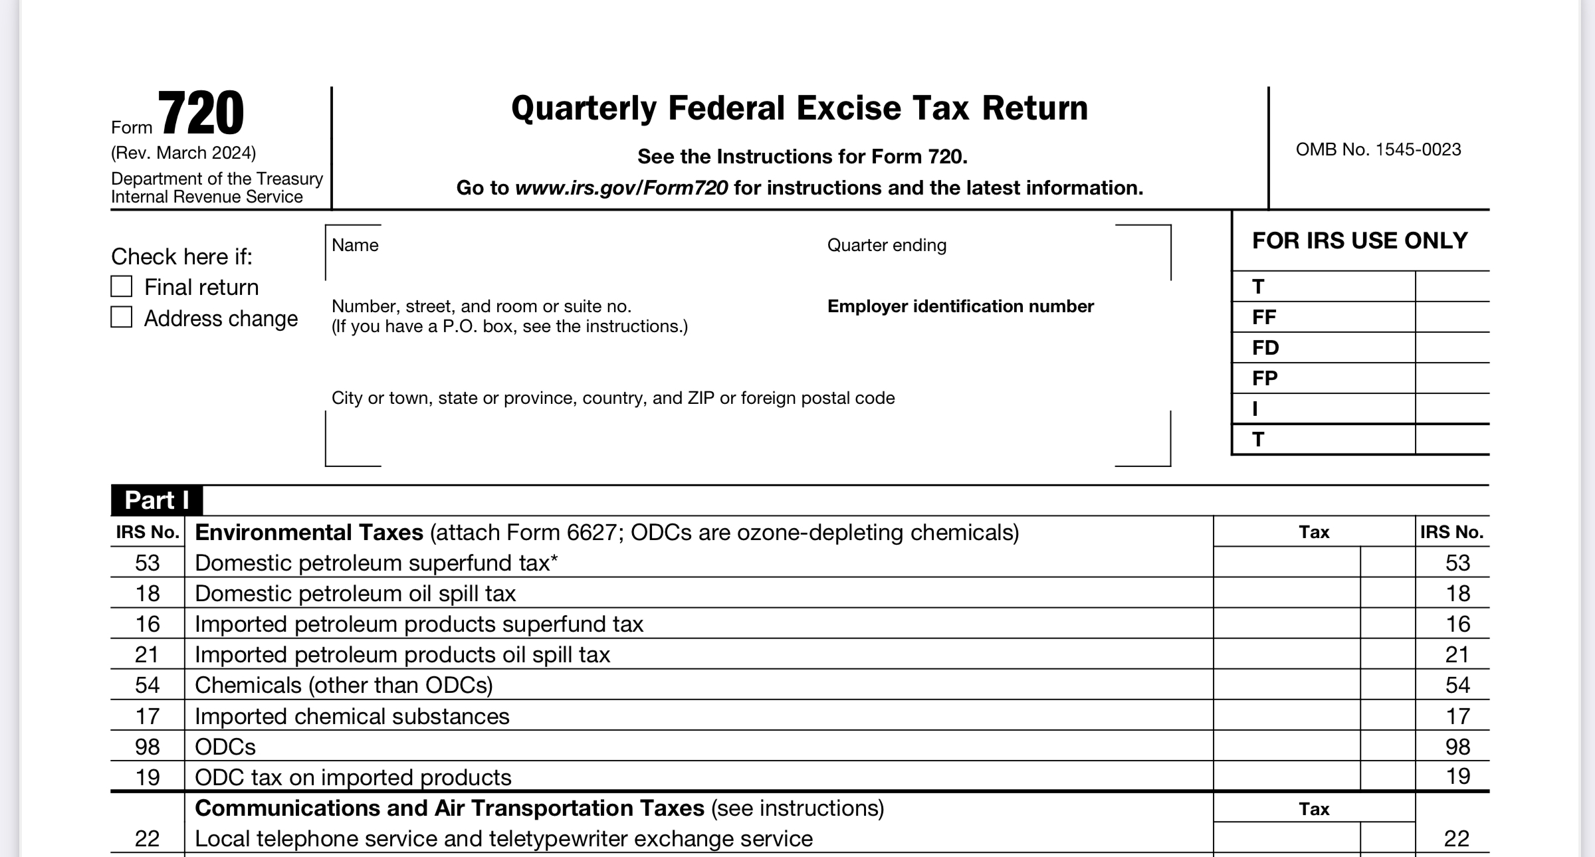

Slide 13
Move to Part II of IRS Form 720

Slide 14
Skip to Part III
for Signature on Page 3
On Page 3 – sign and date
as indicated

Slide 15
Signature Page for Form 720

Slide 16
Skip to Page 8 for
720-V Voucher Form
Do not complete pages 4-7 and do not send them with submission
​
Complete Company info and Use calculated number from page 2, line 133
​
Mail completed Form 720 (not pages 4-7), 720-V and payment to IRS. EFTPS Filers may file and submit fees electronically

Slide 17
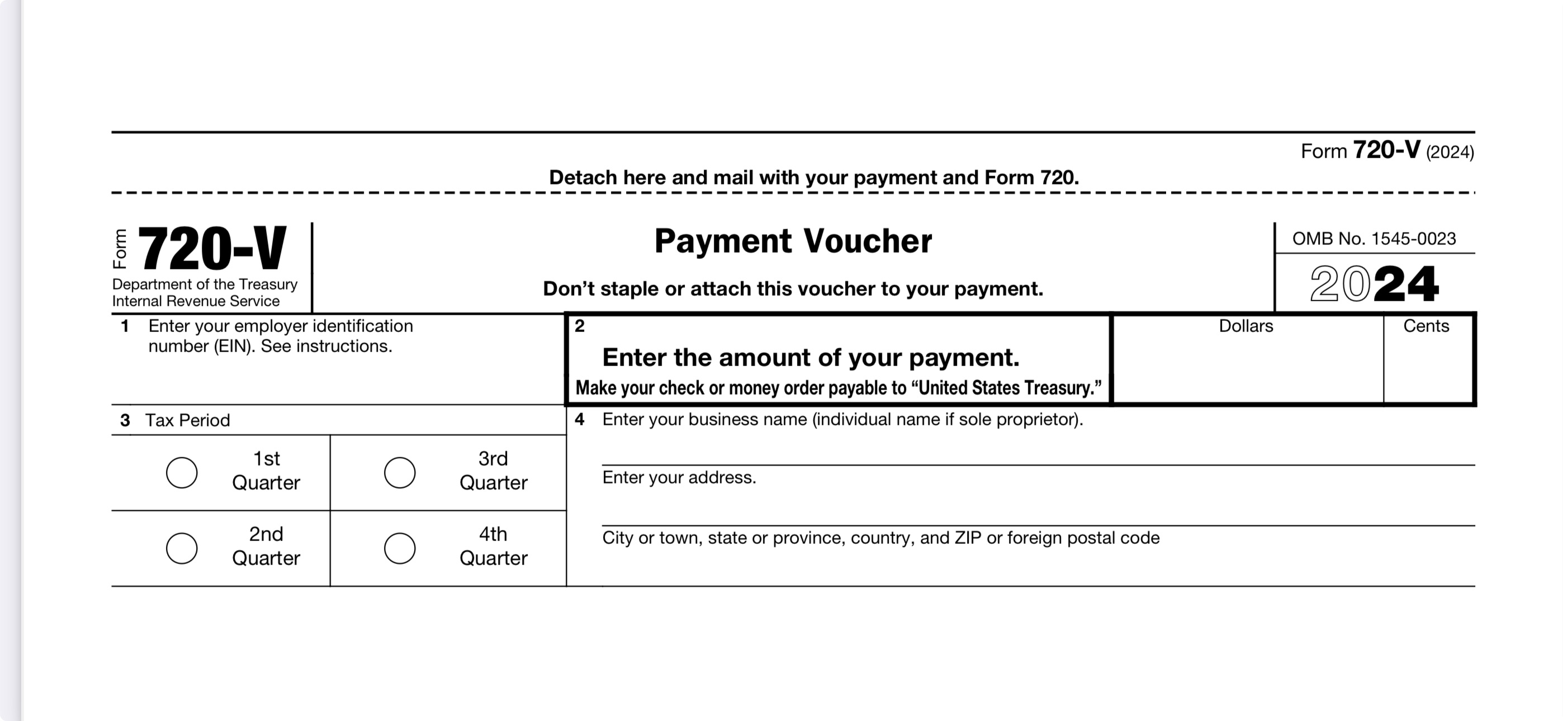
Form 720-V For Payment Submission

Slide 18
JUNE 2024 IRS FORM 720 AND FINAL INSTRUCTIONS
Use this link:
https://www.irs.gov/pub/irs-pdf/f720.pdf
Still complete first box on page 1
Still move to Part II, LIne 133 on page 2
Still use $3.22 per covered person if a self-insured plan ended on or after October 1, 2023 and before October 1, 2024
Still use $3.00 per covered person if a self-insured plan ended on or after October 1, 2022 and before October 1, 2023
Still use enrolled participants for applicable HRA and FSA calculations and not all covered persons
Still use Form 720-V to submit payment-see page 8

Slide 19
Where to Send Form 720 ​
and 720-V With Check
Department of the Treasury, Internal Revenue Service​
Ogden, Utah (UT)​
Zip: 84201-0009​
Go to Page 8 of Form 720 to find 720-V​
​
Send by USPS (Time Sensitive) or Private Mail Service. ​
Go to www.irs/PDS for approved Private Mail Services.​

Slide 20
Payment May Be Made Through the EFTPS
If paid through the Electronic Federal Tax Payment System, PCORI fees should be applied to the second quarter (in EFTPS, select Q2 for the Quarter under Tax Period on the "Business Tax Payment" page).​
Organizations must be enrolled in the Electronic Federal Tax Payment System to pay PCORI fees electronically.​
If your organization does not pay Federal Taxes, you probably aren’t enrolled in the EFTPS. ​
Check this link for more info on EFTPS:​
EFTPS: The Electronic Federal Tax Payment System | Internal Revenue Service (irs.gov)

Slide 21
Don’t Forget to Send Payment with Voucher and Form 720​ by
Wednesday, July 31, 2024
Must Use IRS Form 720-V​
(After Completion of Page 8 of Form 720)

Slide 22
*LATE RELEASE OF JUNE 2024 IRS FORM 720
Click this Link to access most current IRS Form 724:
https://www.irs.gov/pub/irs-pdf/f720.pdf

Slide 23
Salus Group
CLEAN. SIMPLE. UNCOMPLICATED.
PCORI Annual Filing Requirements Under ACA
June 2024
THANK YOU FOR YOUR TIME
AND FOCUS!

Slide 24
Contact Salus Group with Questions
Valerie Bruce Hovland​
V.P. of Compliance
The Salus Group​
586-264-0485 Ext. 5551​
vbrucehovland@thesalusgroup.com

